Slide 1

CAPSTONE PROJECT
MODULE 3
MACHINE LEARNING
CUSTOMER
LIFETIME
VALUE
ROMMY HA PRATAMA
JDSOL-014

Slide 2
TABLE
OF CONTENTS

Slide 3
BUSINES
PROBLEM
DATA
UNDERSTANDING
DATA
ANALYSIS
DATA
PREPROCESSING
MODELING
CONLUSIONS

Slide 4
BUSINESS PROBLEM

Slide 5
CUSTOMER LIFETIME VALUE (MEDIAN)
TOTAL CLAIM AMOUNT
* in mio
* in thousand
+9.9
-278
13.0
879
601
6.3
6.3
6.1
6.3
6.4
6.0
6.2
303
3.1
128
108
116
95
104
111
1
2
3
4
5
6
7
8
9
1
2
3
4
5
6
7
8
9

Slide 6
Problem Statement
Data Analytics
Goals
Problem Statement
Perusahaan ingin menaikkan operating revenue
Perusahaan dinilai kurang efektif dalam kegiatan marketing
Analytics
Perilaku dan karakter nasabah
Mengenali treatment yang tepat kepada nasabah
Goals
Menaikkan revenue dan customer lifetime value nasabah
Efisiensi biaya marketing

Slide 7
EVALUATION METRICS

Slide 8
Case: Regression
RMSE
MAE
MAPE

Slide 9
DATA UNDERSTANDING

Slide 10
5669 rows
11 columns
Vehicle Class
Tipe kendaraan nasabah CAT
Coverage
Jenis asuransi kendaraan CAT
Renew Offer Type
Jenis penawaran perpanjangan asuransi CAT
Employment Status
Status pekerjaan nasabah CAT
Marital Status
Status pernikahan nasabah CAT
Education
Tingkat pendidikan nasabah CAT
Number of Policies
Jumlah polis asuransi yang dipakai nasabah CAT
Monthly Premium Auto
Premi asuransi bulanan yang dibayar nasabah NUM
Total Claim Amount
Total klaim asuransi oleh nasabah NUM
Income
Penghasilan nasabah NUM
Customer Lifetime Value
Nilai yang mengukur potensi revenue dari nasabah NUM

Slide 11
DATA UNDERSTANDING
OUTLIERS & MISSING VALUE

Slide 12
OUTLIERS
MISSING VALUE
4.9%
4.4%
8.8%
0.0%
Monthly Premium Auto
Total Claim Amount
Customer Lifetime Value
Across Dataset

Slide 13
DATA ANALYSIS

Slide 14
DEMOGRAPHY
ECONOMICS
BUSINESS POTENTIAL

Slide 15
DATA ANALYSIS
DEMOGRAPHY

Slide 16
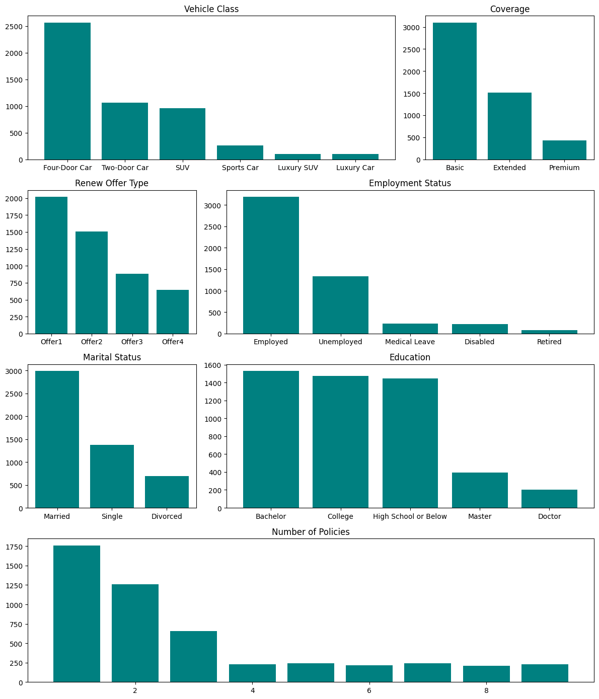

Slide 18
1
3
5
7
9

Slide 19
DATA ANALYSIS
ECONOMICS

Slide 20
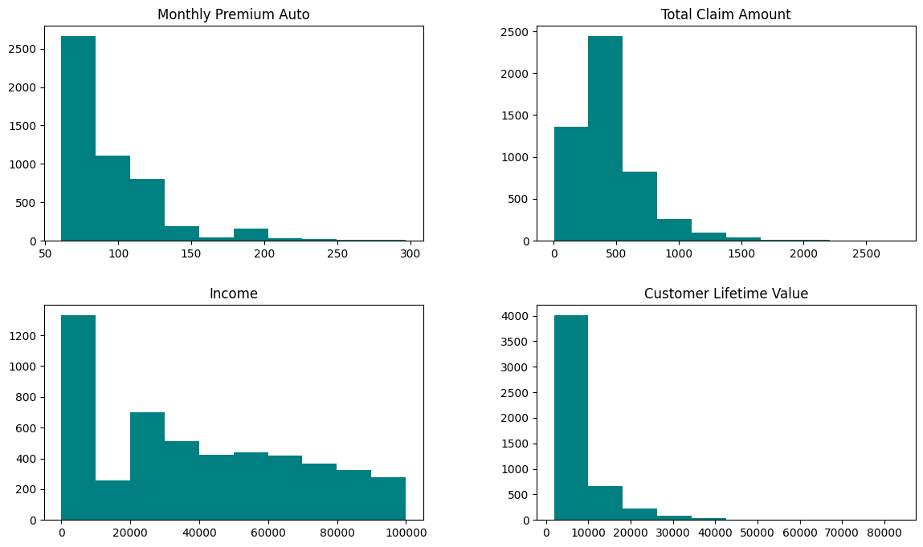

Slide 21
DATA ANALYSIS
BUSINESS POTENTIAL

Slide 23
DATA PREPROCESSING

Slide 24




Duplicate data handling
One format features
MULTICOLLINEARITY
DUPLICATE
OUTLIER
ENCODING
Statistic test
Correlation test
Outlier data handling

Slide 25
DATA PREPROCESSING
MULTICOLLINEARITY

Slide 26
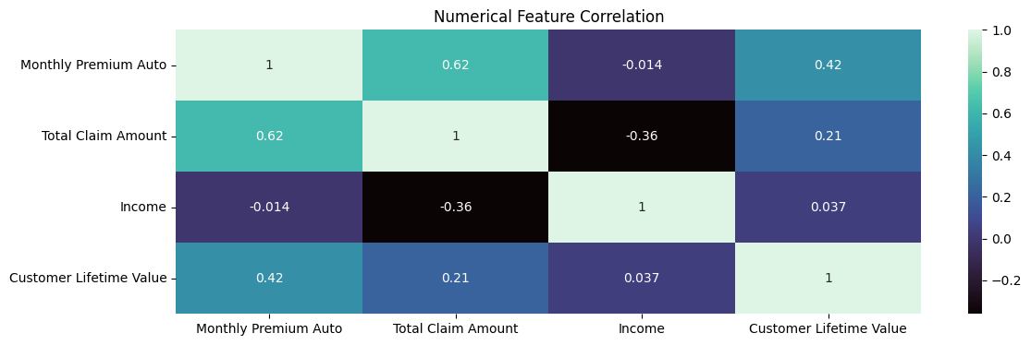
Categoric
Maintain
Vehicle Class
Coverage
Renew Offer Type
Employment Status
Marital Status
Education
Number of Policies
Numeric
Maintain
Monthly Premium Auto
Total Claim Amount
Income

Slide 27
DATA PREPROCESSING
DUPLICATE

Slide 28
620
Duplicates data detected
10.9%
Duplicates across dataset
Action: Delete duplicates
Notes:
10.9%

Slide 29
DATA PREPROCESSING
OUTLIER

Slide 30
4.9%
4.3%
8.8%
Monthly
Premium Auto
Total
Claim Amount
Customer
Lifetime Value
Action: Delete outliers
Notes:
10.9%

Slide 31
DATA PREPROCESSING
ENCODING AND SCALER

Slide 32
Preprocessing | Method | Data
Encoder | Onehot | Vehicle Class, Employment Status, Marital Status
 | Ordinal | Coverage, Renew Offer Type, Education
Scaler | MinMax | Monthly Premium Auto, Total Claim Amount, Income
Original Data |  | Ordinal Encoded
Coverage |  | Coverage | Ordinal
Basic |  | Basic | 1
Extended |  | Extended | 2
Premium |  | Premium | 3
Original Data |  | Onehot Encoded
Marital Status |  | Marital Status | Married | Single | Divorced
Married |  | Married | 1 | 0 | 0
Single |  | Single | 0 | 1 | 0
Divorced |  | Divorced | 0 | 0 | 1

Slide 33
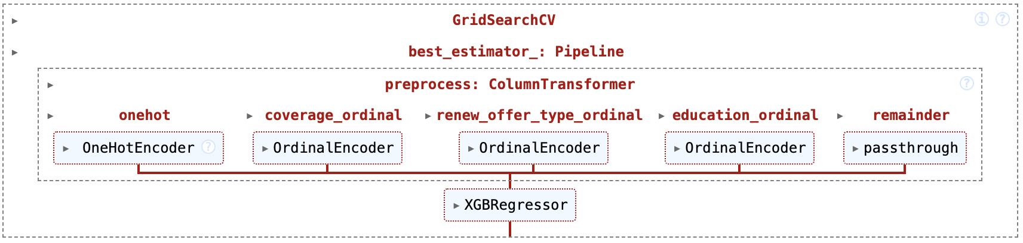
PIPELINE

Slide 34
MODELING

Slide 35
MODEL
Linear Regression
Decision
Tree
KNN
Random Forest
Xtreme Gradient Boosting

Slide 36
MODELING CROSS VALIDATION

Slide 37
Rank | Model | Mean RMSE | STD RMSE | Mean MAE | STD MAE | Mean MAPE | STD MAPE
1 | XGB Regressor | -1024.1232 | 48.6115 | -490.9173 | 18.4175 | -0.0737 | 0.0020
2 | Decision Tree Regressor | -1054.3988 | 60.5025 | -553.4756 | 23.3073 | -0.0748 | 0.0017
3 | Random Forest Regressor | -1688.3147 | 99.1281 | -1129.6758 | 51.9020 | -0.1975 | 0.0040
4 | KNN Regressor | -2067.9497 | 65.3483 | -1252.7731 | 30.3309 | -0.1809 | 0.0043
5 | Linear Regression | -2790.9079 | 115.3169 | -2097.6375 | 67.5556 | -0.3837 | 0.0087
Rank: RMSE

Slide 38
MODELING
HYPER PARAMETER TUNING

Slide 39
Selected Model: Xtreme Gradient Boosting
Parameters | Tested
learning_rate | 1, 0.2, 0.1, 0.05, 0.02, 0.005, 0.002
n_estimators | 20, 100, 200, 400, 800, 1000, 1200
max_depth | 3, 4, 5, 6, 7, 8
Parameters | Best
learning_rate | 0.005
n_estimators | 1000
max_depth | 4

Slide 40
MODELING EVALUATION

Slide 41
BEFORE TUNING
RMSE | MAE | MAPE
897.17 | 439.66 | 0.065
AFTER TUNING
RMSE | MAE | MAPE
851.12 | 344.54 | 0.044
Potensi eror prediksi improve dari 6.52% menjadi 4.42%

Slide 42
MODELING FEATURE IMPORTANCE

Slide 43
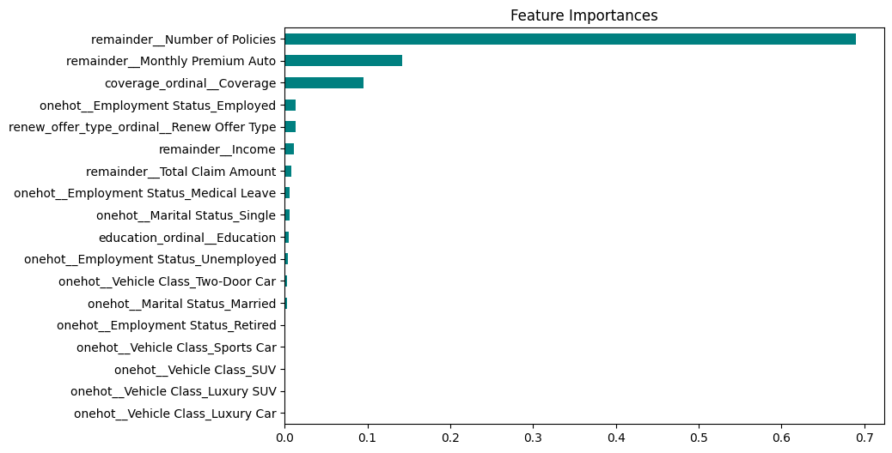

Slide 44
MODELING RESIDUAL

Slide 45
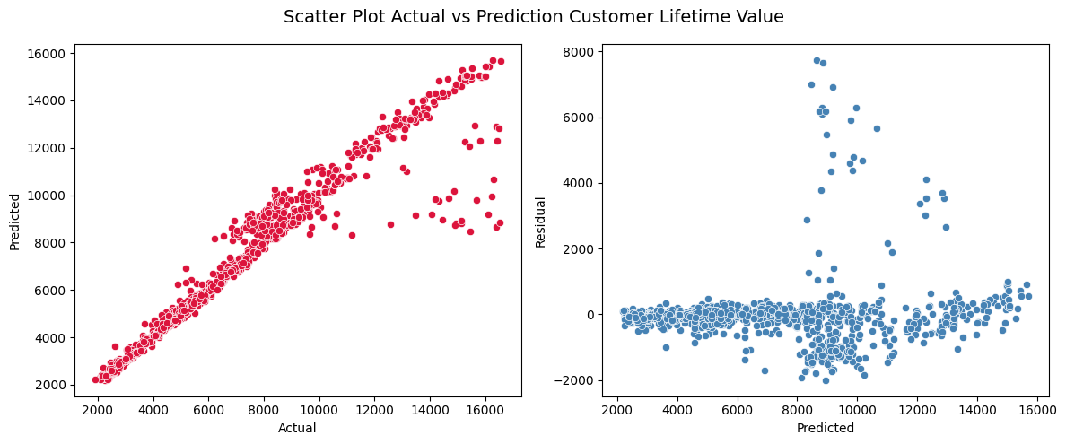

Slide 46
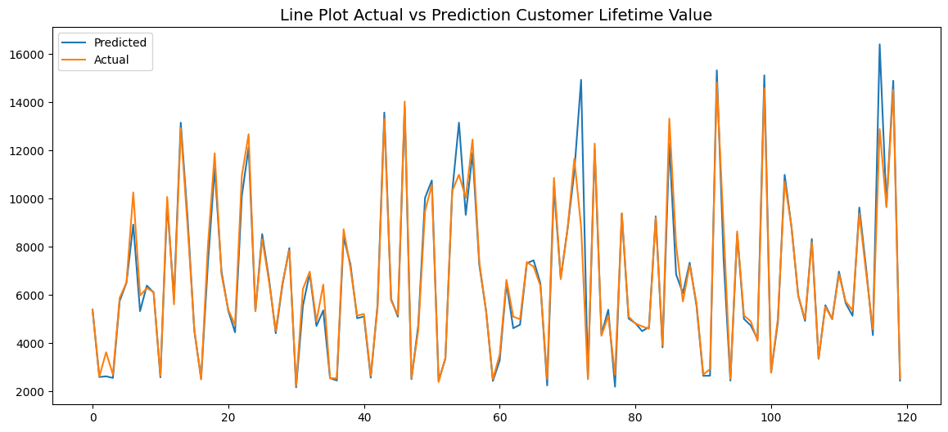

Slide 47
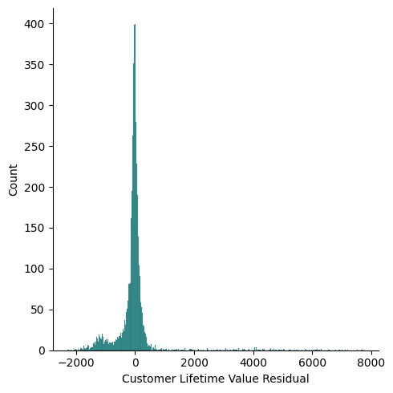

Slide 48
MODELING LIMITATION

Slide 49
CLV
Model dilatih dengan data Customer Lifetime Value antara 0 - 16589
TIME
Belum ada data durasi seseorang menjadi nasabah asuransi
CAR
Belum ada data jumlah kendaraan yang dimiliki nasabah

Slide 50
BUSINESS
IMPACT

Slide 51
Before
Total klaim asuransi nasabah dengan 1 polis
Revenue dari nabasah dengan Coverage – Basic
Revenue dari nasabah dengan Renew Offer Type
After
20% nasabah pindah ke 2 polis dan total klaim turun
20% nabasah uplift menjadi Coverage – Extended
20% nasabah uplift menjadi Renew Offer Type offer 1
1 Policy
175,731
2 Policy
171,806
Absolut | %
-3,924 | -2.2%
Basic
48,678
Extended
63,977
Absolut | %
15,299 | 31.4%
Offer 2 | Offer 3 | Offer 4 | Total
28,993 | 14,040 | 9,502 | 52,535
Offer 1
60,786
Absolut | %
8,251 | 15.7%

Slide 52
CONCLUSIONS

Slide 53
MODEL
BUSINESS
XG Boost dipilih karena hasil evaluasi paling baik.
Model yang sudah dituning mencatat RMSE 851.12 MAE 344.54 MAPE 0.04. Artinya kemungkinan eror dari prediski sebesar 4.42%.
Nasabah dengan > 1 polis asuransi punya nilai Customer Lifetime Value lebih tinggi.
Model mampu memprediksi nasabah dengan nilai Customer Lifetime Value < 8000 dengan tepat.
Nasabah dengan 2 polis punya kecenderungan melakukan klaim lebih sedikit dibanding nasabah dengan 1 polis.
Income tidak berpengaruh pada Customer Lifetime Value tapi premi bulanan berpengaruh paling kuat, dibuktikan dengan hasil uji korelasi sebesar 0.42.
Perusahaan bisa menaikkan potensi revenue dengan uplift Coverage dan Renew Offer Type.

Slide 54
RECOMMENDATIONS

Slide 55
MODEL
BUSINESS
Utamakan penggunaan model untuk memprediksi nasabah dengan Customer Lifetime Value < 8000 dan hindari memprediksi Customer Lifetime Value > 8000.
Uplift 1 polis menjadi 2 polis potensi efisiensi Total Claim Amout $9.77 per nasabah.
Uplift Coverage Basic menjadi Extended potensi kenaikan revenue $12 per nasabah.
Uplift Renew Offer Type 2, 3, dan 4 menjadi 1 potensi kenaikan revenue $11 - $16 per nasabah.
Perusahaan perlu menambah data seperti durasi nasabah berlangganan asuransi dan jumlah kendaraan seorang nasabah untuk mengurangi limitasi pada model.
Program retensi dan loyalty pada nasabah dengan Customer Lifetime Value > 8000.

Slide 56
THANK YOU

